Slide 1
Road Accidents in Canada Explored (Project RACE)
Presented by:
Syed Tasrif Ahmed - 200409216
Tolu Fatoki - 200384759
July 10, 2020

Slide 2
TEAM MEMBERS AND TASK
Team Member | Task
Tolu Fatoki | Data Analysis and Exploration with python, Build machine learning model, Testing Project Documentation
Syed Tasrif Ahmed | Web development, Build interactive visuals with chart.js, Build Machine learning model, Testing ,Documentation

Slide 3
Outline
Introduction
Solution Overview
Tools
Methodology
Limitation
Conclusion

Slide 4
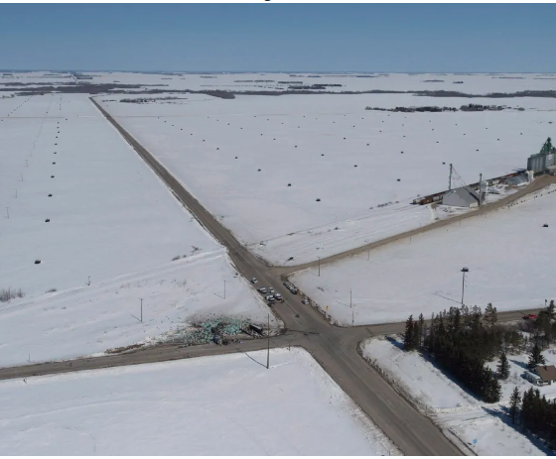
Introduction
The importance of road transport to any country and its economy and keeping the roads safe is a top priority for any government
US crash record in 2015 shows that 47% of road accidents occurred at intersections and also in Ontario, Canada 42% of accidents are intersection related
The government Canada has an initiative to achieve road safety with its Road Safety Strategy 2025
Our aim is to help the government in achieving this goal with the help of machine learning
Notes:
In a record in 2015 47% of road accident occured in intersection in US. Moreover, in Canada 42% collusions take place in intersection area.
So govt of Canada took a measure to achieve safe road by launching Road Safety Strategy 2025
Keeping this in our head, we set our project topic and
In this scenario our goal is to help government to achieve this goal by providing a machine learning solution.

Slide 5
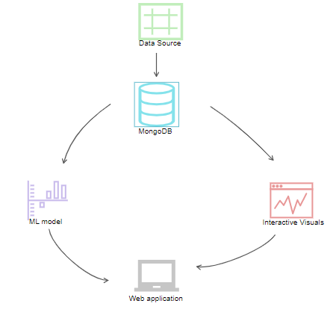
Solution Overview

Slide 6






Tools

Slide 7
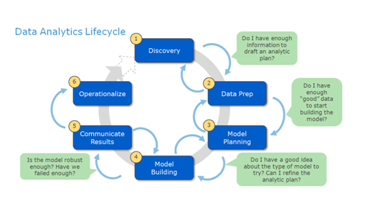
Methodology

Slide 8
Discovery
How can road accidents in Canada be reduced considering the effect of road configuration.

Slide 9
List of Road Configuration
Non-intersection
At an intersection of at least two public roadways
Intersection with parking lot entrance/exit, private driveway or laneway
Railroad level crossing
Bridge, overpass, viaduct
Tunnel or underpass
Passing or climbing lane
Ramp
Traffic circle
Express lane of a freeway system
Collector lane of a freeway system
Transfer lane of a freeway system

Slide 10
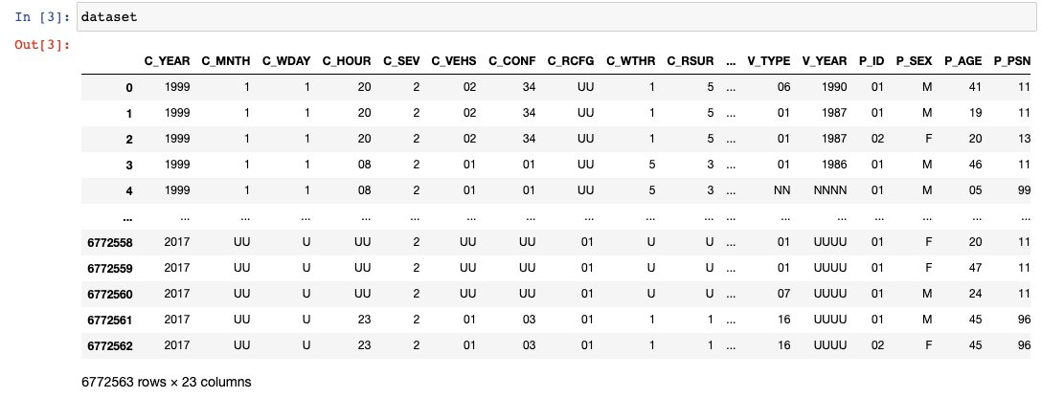
Data Preparation
The dataset contains information about road reported road accidents from 1999-2017
It was sourced from the government of Canada website
Originally stored as a CSV file

Slide 11
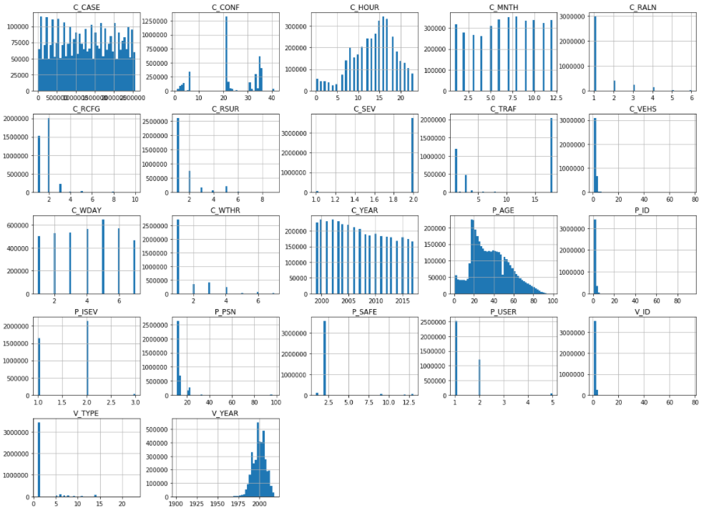
Data Visualization

Slide 12
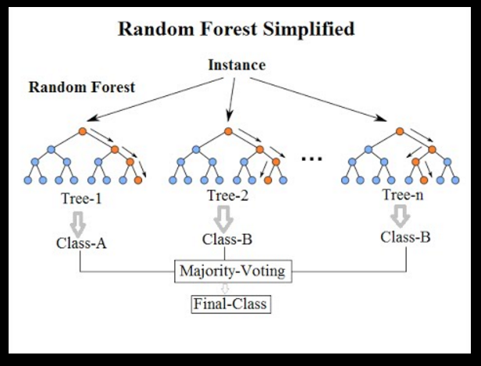
Model Planning
The supervised learning algorithm called Random Forest was employed to tackle this problem

Slide 13
Model Building
Four steps were executed in this phase and they include;
Feature Selection and Feature Engineering
Model Training
Model Prediction
Model Evaluation

Slide 14
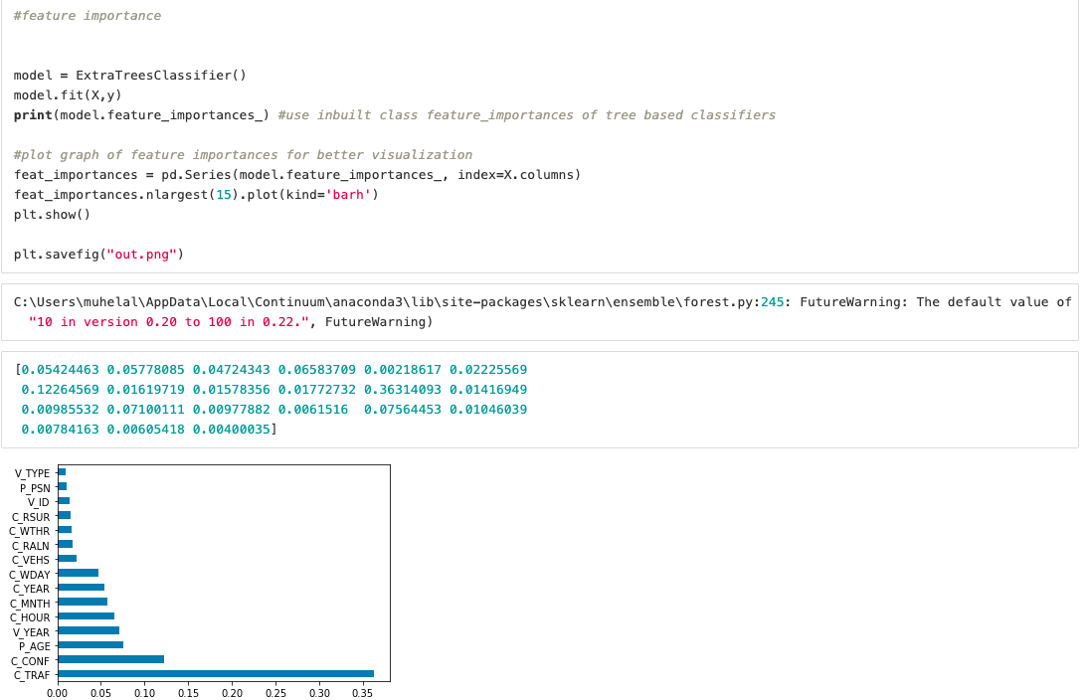
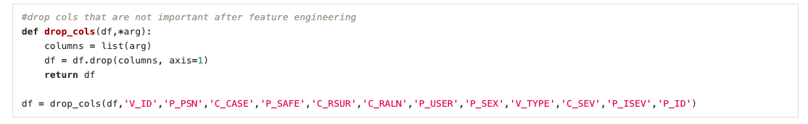
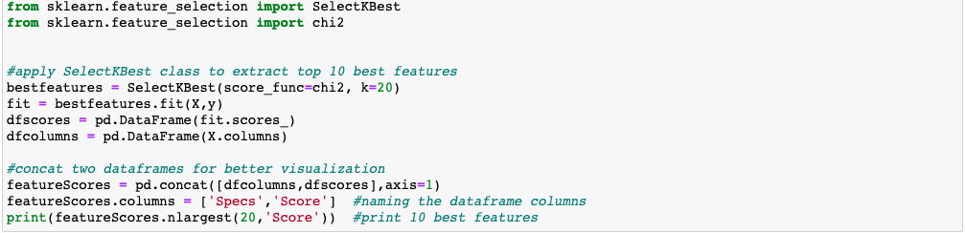
Feature Selection and engineering

Slide 15
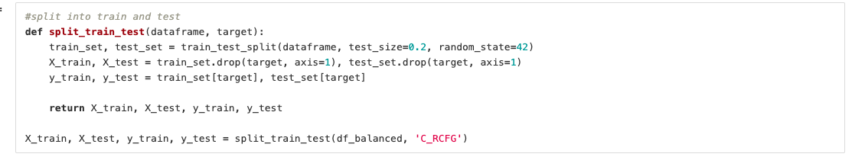
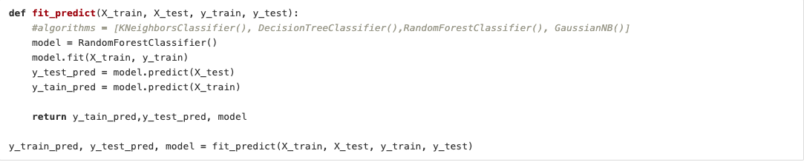
Model Training

Slide 16
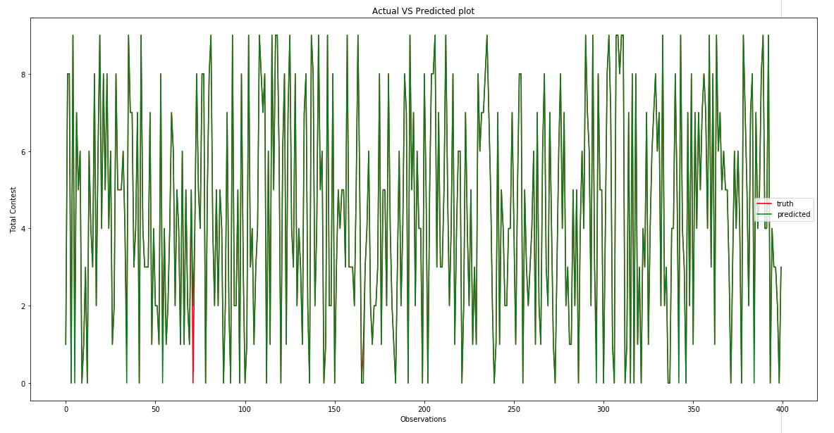
Model Prediction

Slide 17
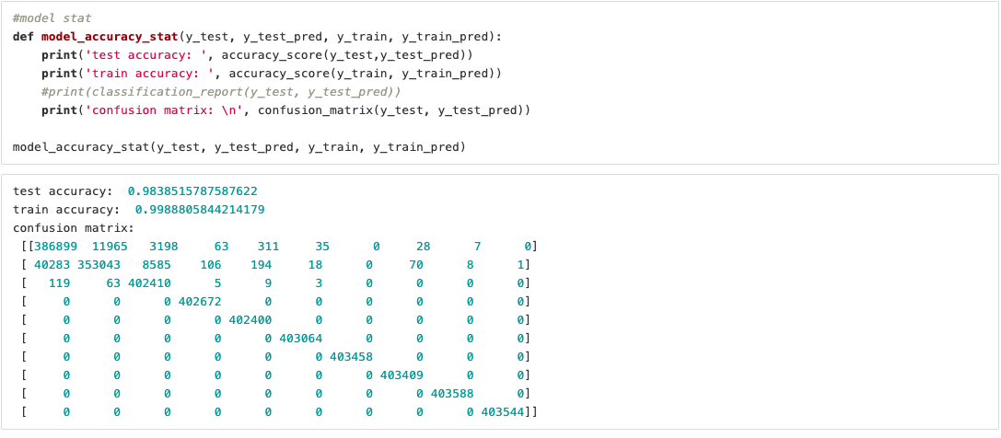
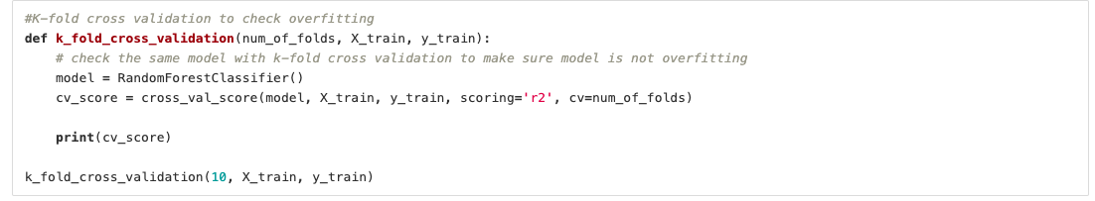
Model Evaluation

Slide 18
Communicate Result
MACHINE LEARNING ALGORITHM | TRAINING ACCURACY | TEST ACCURACY
KNN | 0.9989065177868144 | 0.9840061862864363
Decision Tree | 0.9998788949060914 | 0.9771441433526953
Random Forest | 0.9988805844214179 | 0.9838515787578622

Slide 19
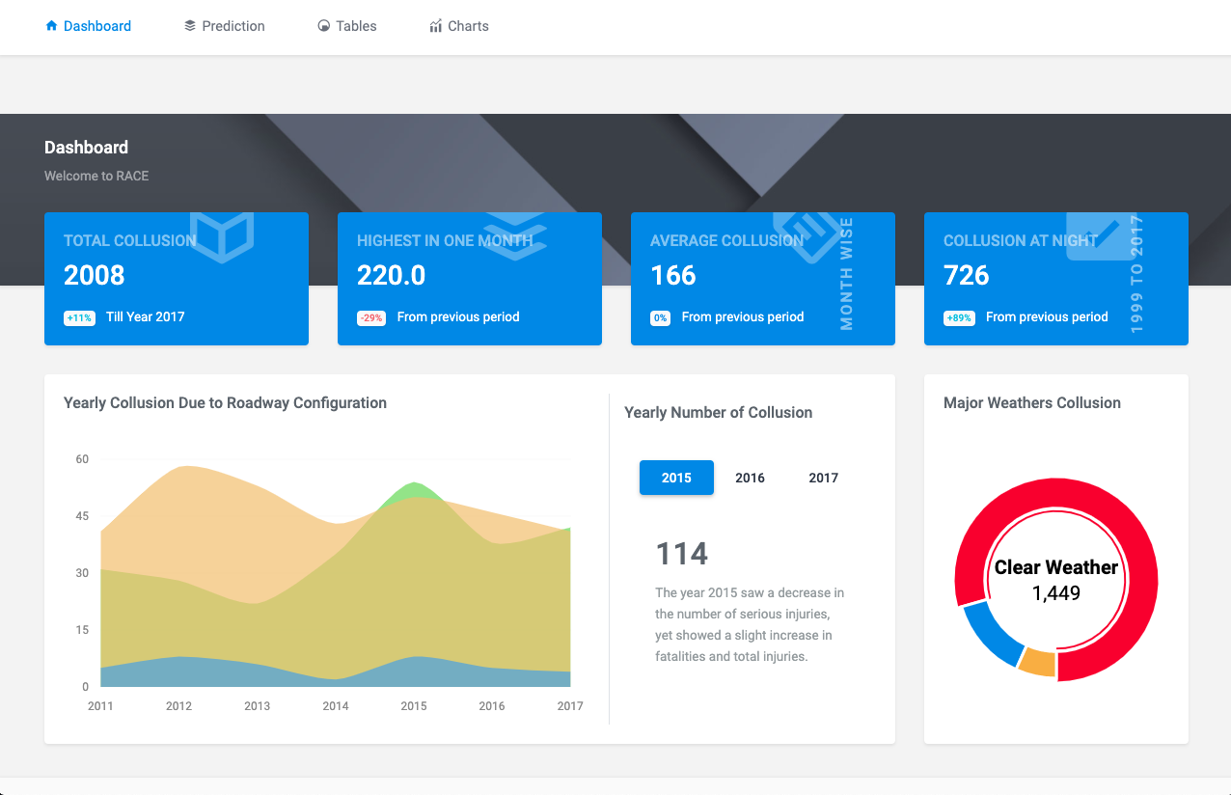
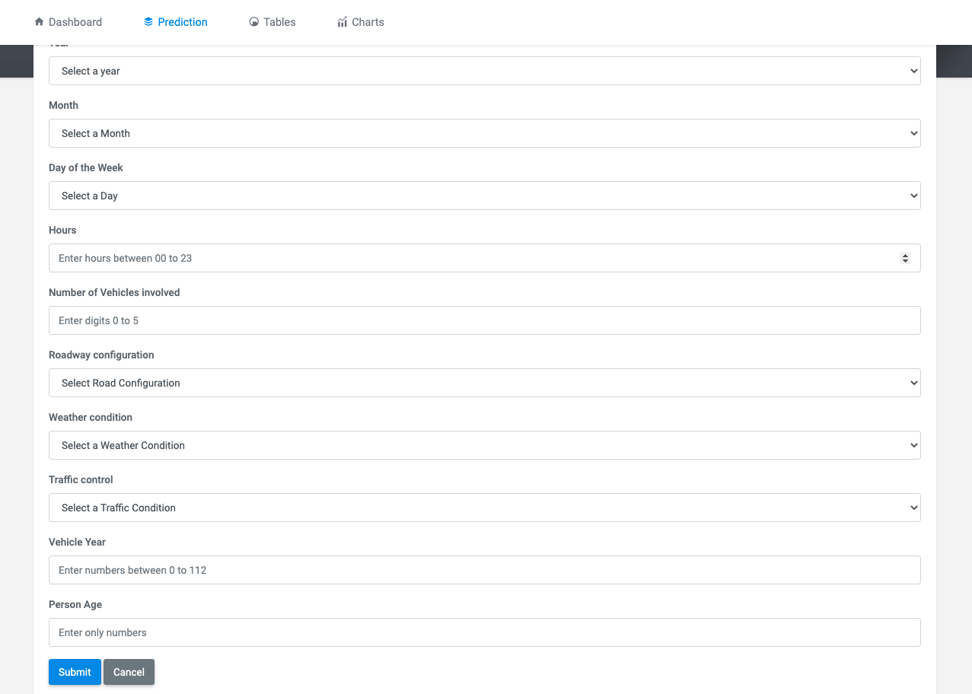
Operationalize

Slide 20
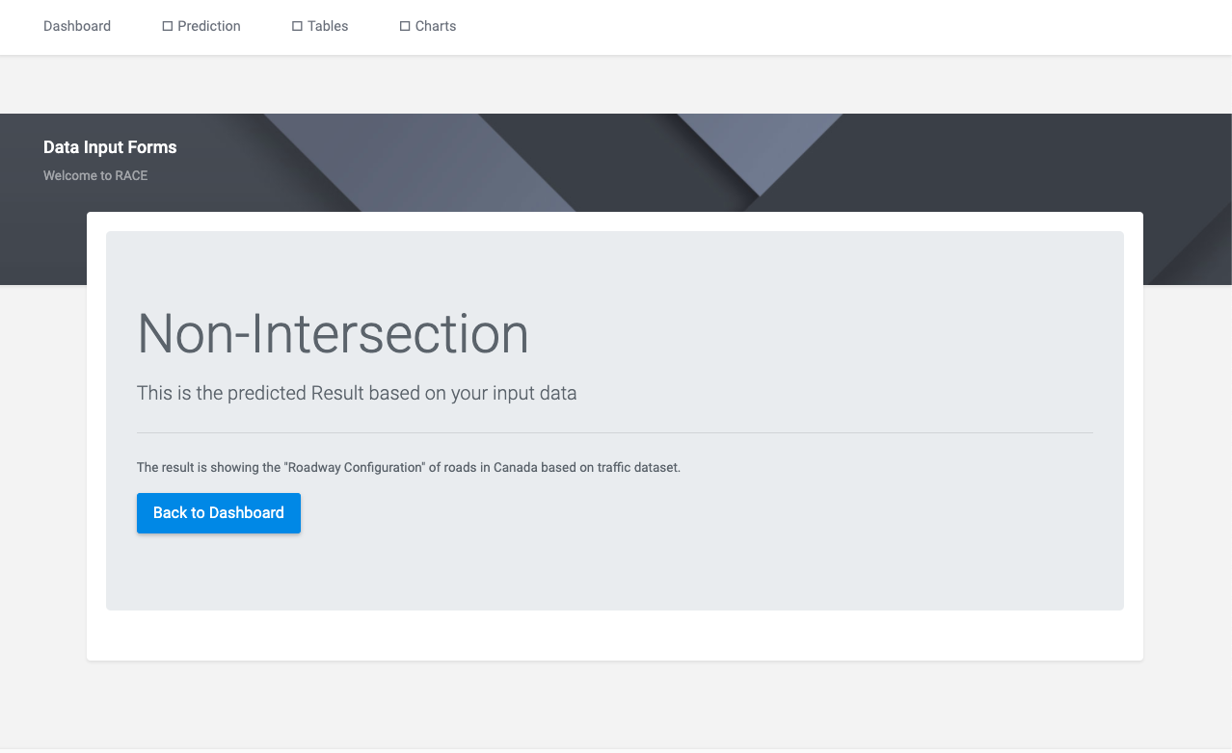
Operationalize

Slide 21
Limitation
Large dataset, the selected data was large and storing and accessing it for both the python analysis and web application development was a great concern
Due to the pandemic during the execution of the project, we could not physically reach out to stakeholders to hold the necessary meetings and gather important requirements from them
Lack of sophisticated machines made our development process slower than expected which affected building the machine learning model and executing it in the web application.

Slide 22
Conclusion
In this report we have highlighted the process within the data analytic lifecycle that we employed to execute the process of predicting road accidents at different identified hotspots within Canada. Our dataset was gotten from the government of Canada website and with this dataset we built a machine learning model using the random forest algorithm that can make prediction of the collision hotspots within Canada. We ultimately built a website where users can interact with different features of the dataset and the predictive model. All of our project files, codes and guides can be found the github repository provided here.

Slide 23
THANK YOU!!

